Slide 1
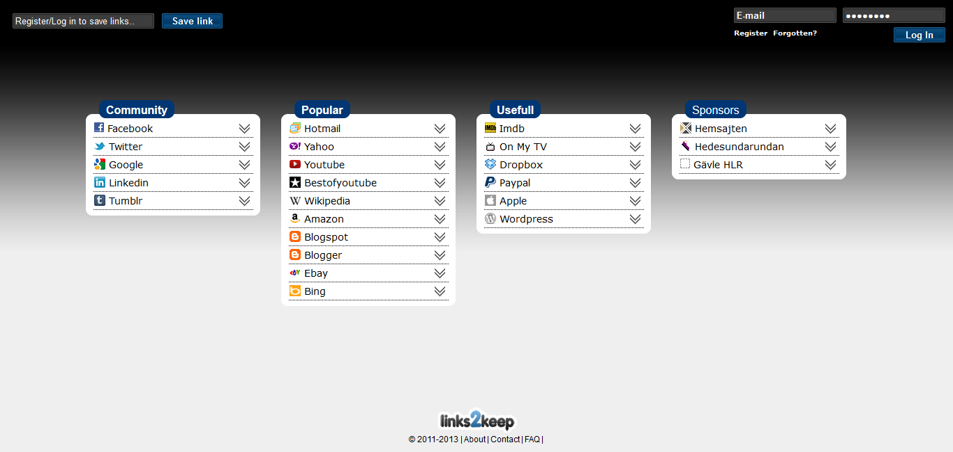
Links2keep - Turtorial

Slide 2
Links2keep
It´s here all your links will be displayed. Those being displayed now will be removed when you register your own account.

Slide 3
Links2keep
This is where you log in, register for a new account or retrive your lost password.

Slide 4
Links2keep
This is where you type or paste the adress you want to save.
Only works when you are logged in (see it in action on slide 13).

Slide 5
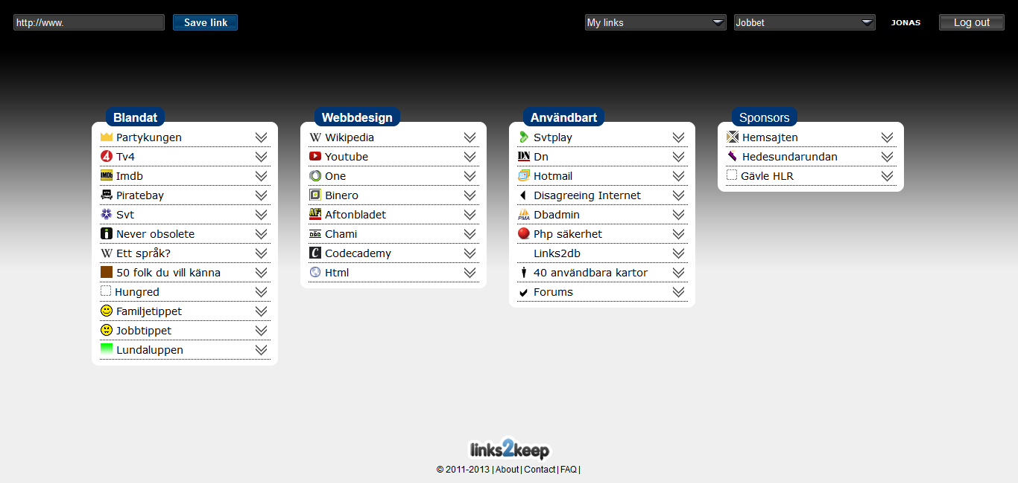
Links2keep
Notice the ”Log out”-button that appears on the upper right corner when you log in.

Slide 6
Links2keep
Your account name is displayed when logged in, to make sure you are logged in as the correct user. Go to ”account options” by clickning the account name (see it on slide 14).

Slide 7
Links2keep
When creating your account, you get 3 different ”views”. Each view contain 3 ”fields”. Here you can switch between the views and also change the names of your ”fields”.
Field name
View name
Field
View

Slide 8
Links2keep
From here you can join, create or manage groups. In a group all members get access to the links and all admins can add new links. You´re private links are called ”My links”.

Slide 9
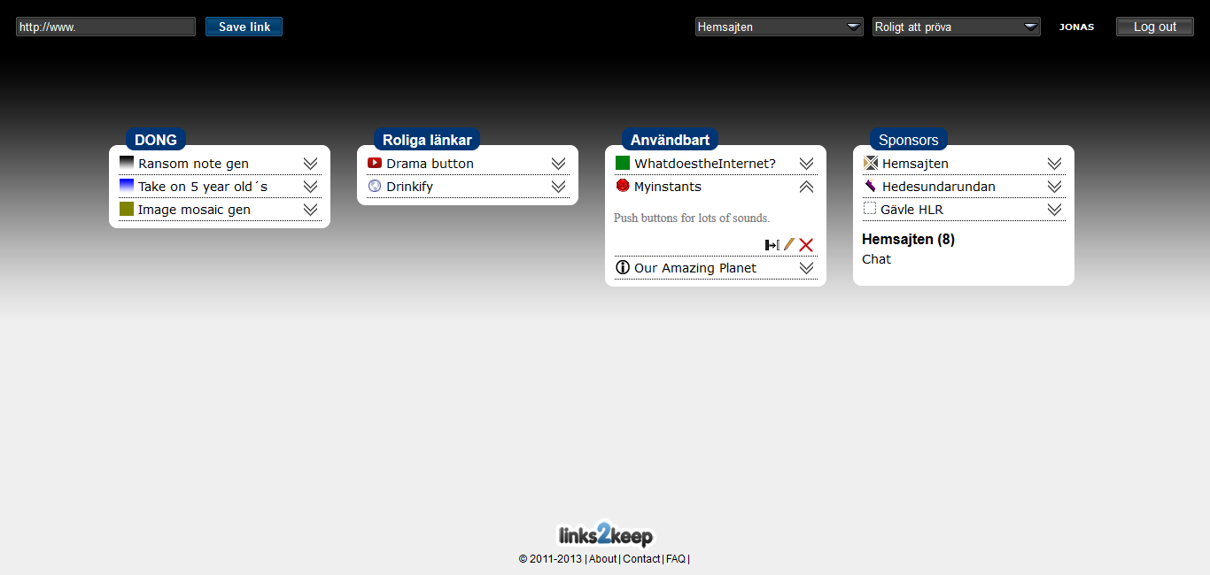
Links2keep
Clicking the arrow will reveal the description of a link and some options for handling it.

Slide 10
Links2keep
Already added links can be copied to other fields, views or groups.
Quick copy puts a copy of the link in your first ”field” on the first ”view”.

Slide 11
Links2keep
Already added links can be edited.

Slide 12
Links2keep
Already added links can be deleted.

Slide 13
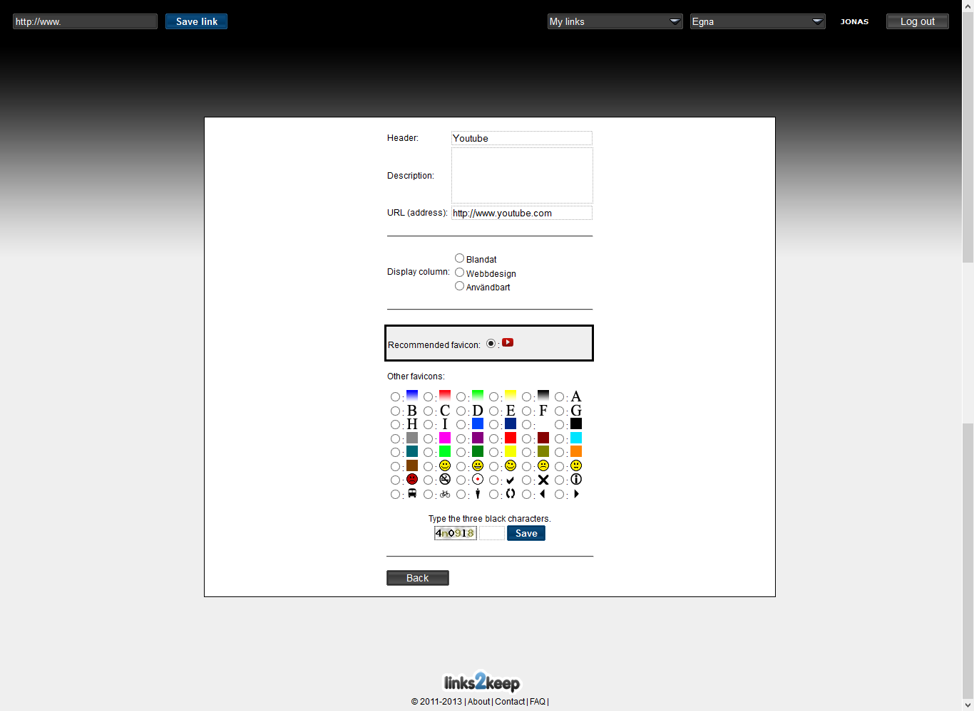
Name to be displayed
Optional description of your link
The URL to follow
What field the new links should be displayed in
Favicon to display
Optional favicons to display
Safety question to answer. Type all black characters (3)

Slide 14
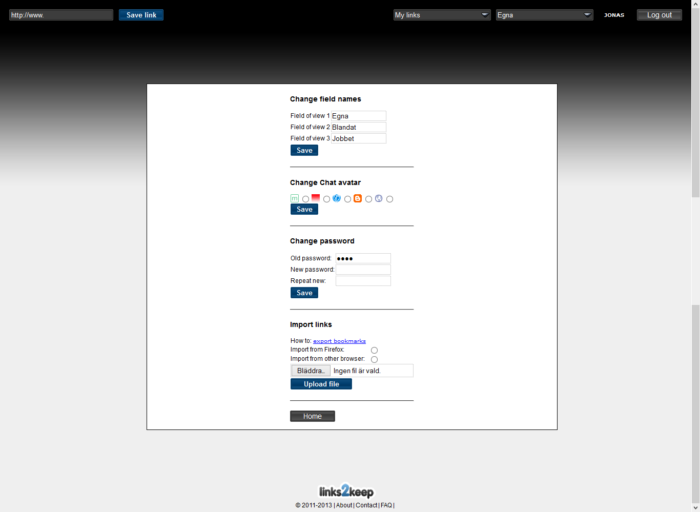
Change the name of your fields
Change your avatar, displayed in group chat room
Change your password
Import a file containing saved links from your Internet browser.
Follow link to learn how to.

